Slide 1
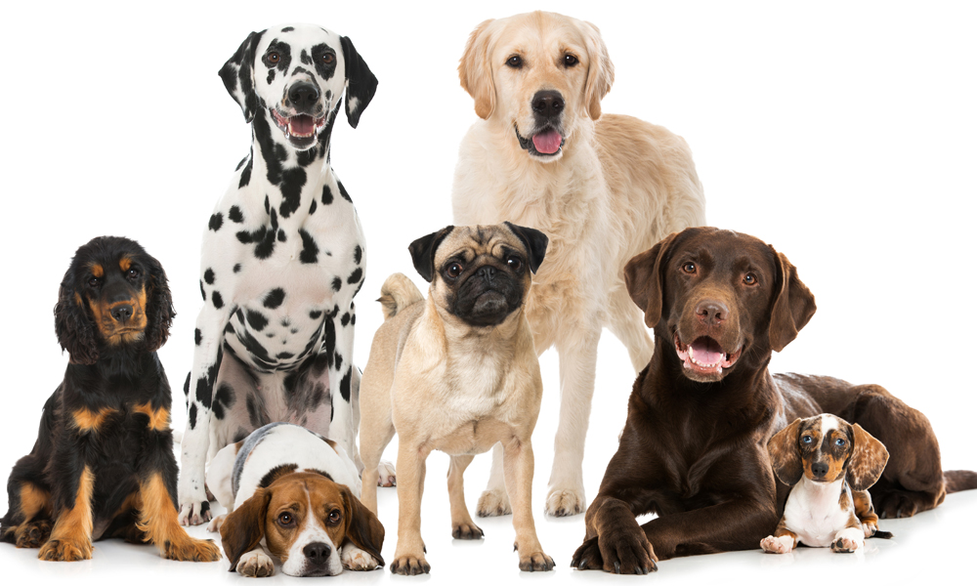
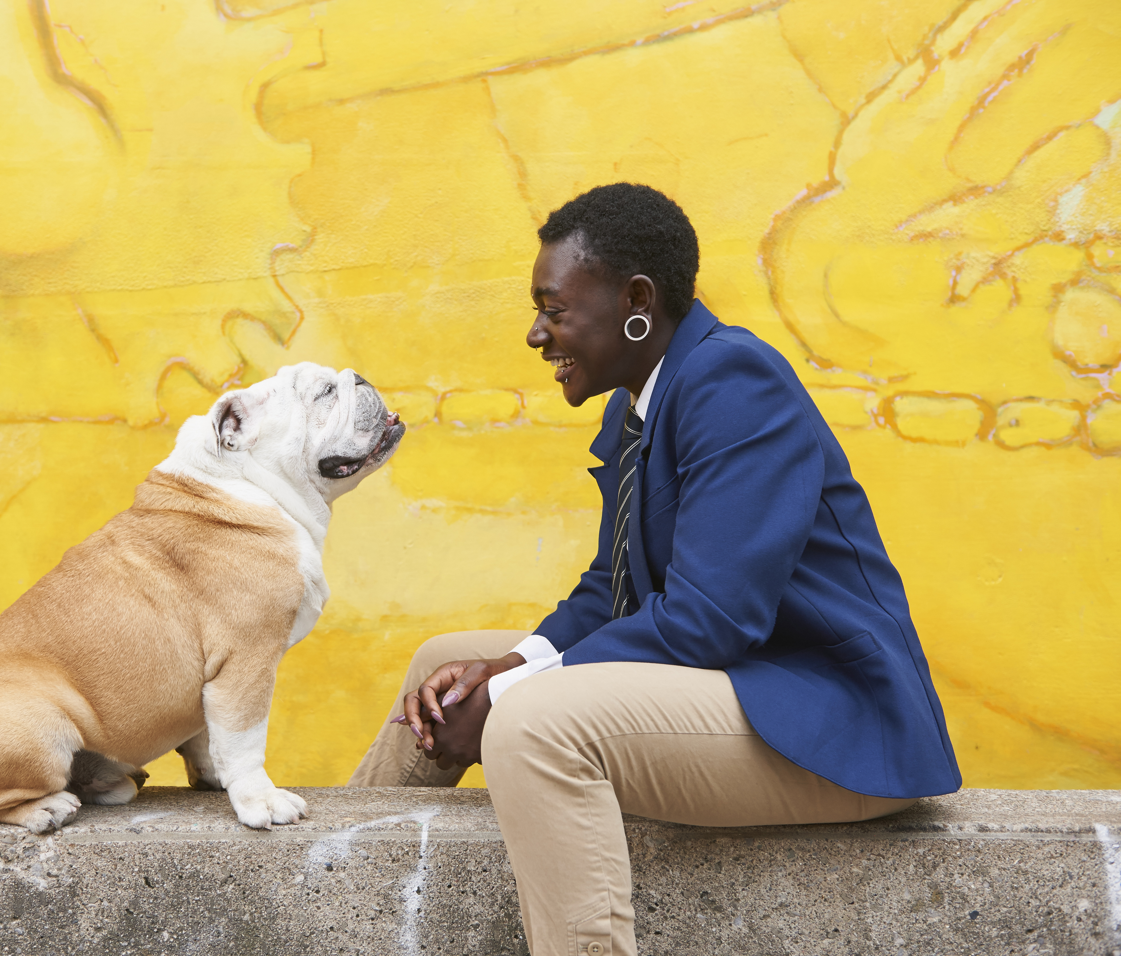
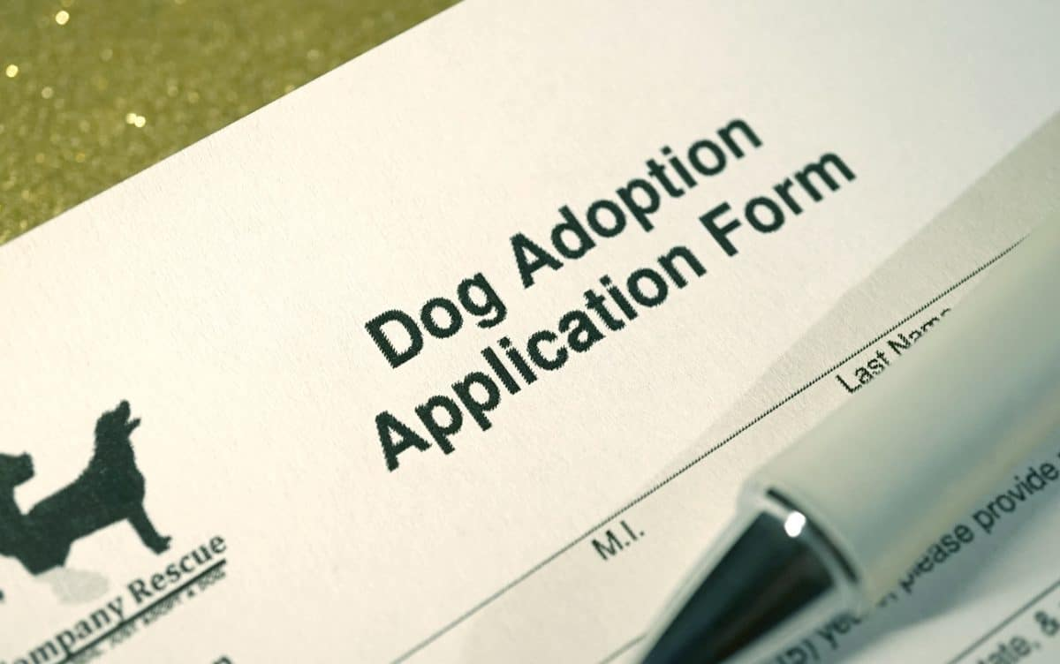
Save A Dog
Adrian Alexander
Kelly Arseneau
Samantha Greenberg
Momisola Odeyemi
Gloria Wu

Slide 2

Why A Dog Adoption Database?
The Business Need:
Centralized place for information and streamline communication
Database to expedite the process
Filter to match dogs based on certain criteria
Make informed decisions
Goals:
Facilitate the successful matching of dogs
Manage information and have everything in one place.
Have filters to pair dogs with potential adopters
Notes:
The Business Need:
The dog adoption database will provide a centralized place for having information about dogs available for adoption, adopters, and the adoption process itself. This will make it easier to access information and streamline communication between all parties involved.
The database will also help expedite the process and make sure things run smoothly for both the adopters and our organization. This will lead to more successful adoptions and dogs will go to their forever homes.
Potential adopters will be able to filter to match dogs based on certain criteria, such as breed, size, age and lifestyle preferences. This will lead to more successful matches between the dog and adopter.
With the database and the data we collect, we'll be able to make informed decisions about how to best market and leave room for long-term planning. We'll be able to promote adoption events, share success stories, and even ask for volunteers through this database.
The Goal:
Similarly to the business need, the goal of the dog adoption database is to facilitate the successful matching of dogs in need of homes with the proper adopter while also making sure everything runs smoothly in the process.
We want to be able to manage information related to the dogs available for adoption and have everything in one place.
We also want to have filters or ways to pair dogs with potential adopters that would be on the best factors for the adopter. We want to reduce the risk of dogs being returned or having to re-home the dogs.

Slide 3
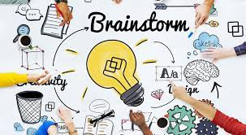
Entities/Attributes:
Dog
ID (Primary Key)
Name
Breed
Age
Gender
Size
Coat Color
Vaccination Status
Microchip Y/N
Temperament
Adoption Status
Image of dog
Entities/Attributes:
Adopter
ID (Primary Key)
Name (First, Last)
Email
Phone Number
Username
password
Entities/Attributes:
Application
Dog_ID (Primary Key)
Adopter_ID
Application_date
Fee_status (paid/not paid)
Relationships:
Dog – Application
Zero or one- to- many- (each dog could have 0, 1, or more applications to adopt)
Adopter - Application
Zero or one to many (each adopter may be interested in adopting 0, 1, or more.
Entities Summary:
Dog – Represents the individual dogs available for adoption
Adopter – Represents individuals or families interested in adopting a dog
Applications –Represents the entity that brings the adopter and the dog together. It also gathers the necessary information from the adopters

Slide 4
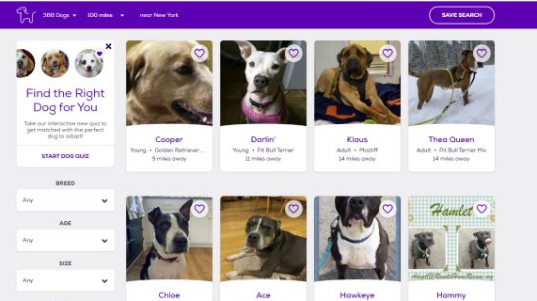
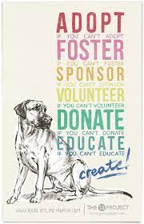
The vision for our database

Slide 5
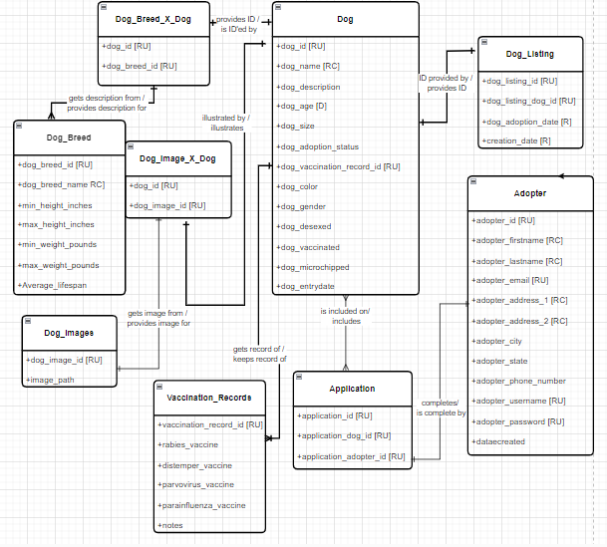
Conceptual Data Model

Slide 6
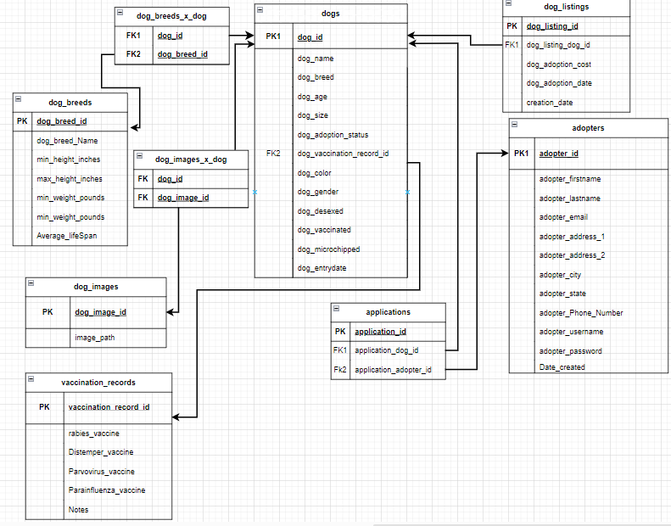
Logical Data Model
Notes:
Needed applications table as bridge table for dogs and adopters; had to get rid of dog description due to multiple values in a single column,

Slide 7
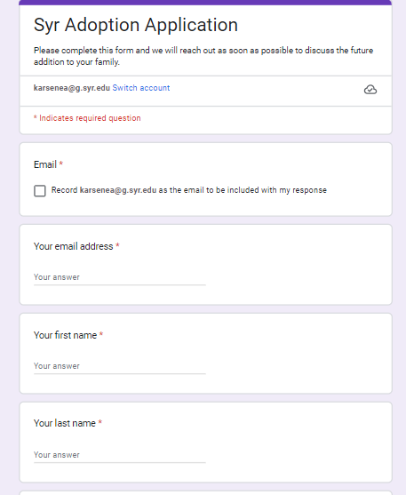
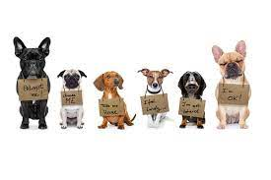
SYR Dog Adoption Application

Slide 8
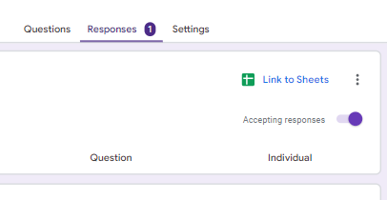
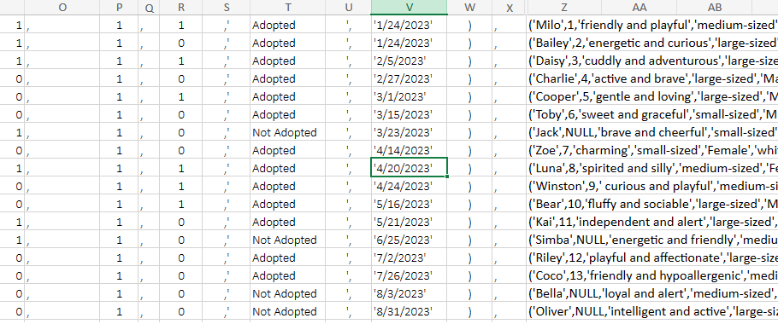
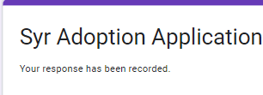
Insert Statements

Slide 9
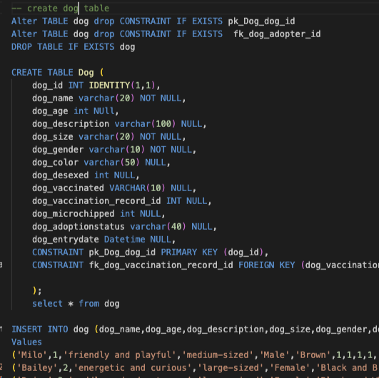

up/down code
This example code creates the dog table and inserts the data/metadata for each attribute
We've added the drop clauses that apply to the constraints and Table
Using drop " " if statements requires checking if the existence of what's being dropped, THEN dropping it if it does; checking "if exists" first reduces errors if/when an something doesn't exist.

Slide 10
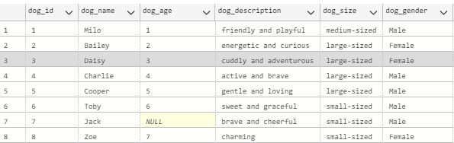
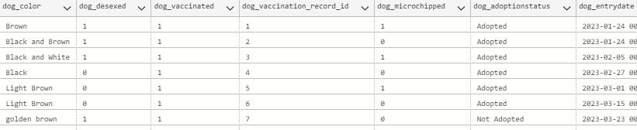
Product of up/down Dog Table

Slide 11
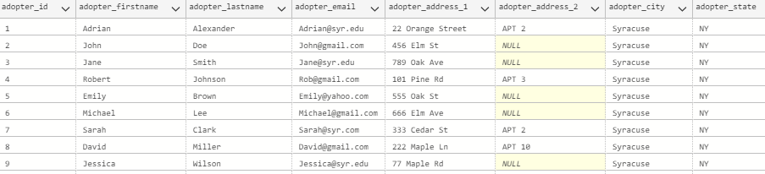
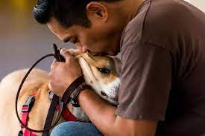
Demonstration of Implementation
Adopters

Slide 12
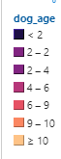
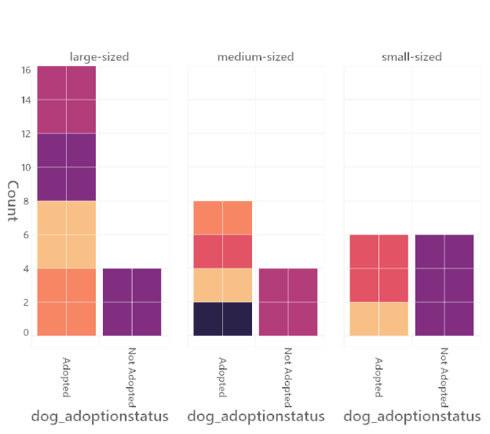
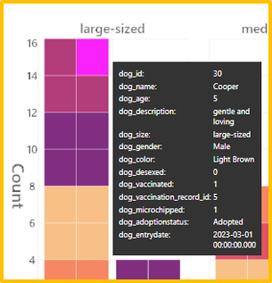

Slide 13
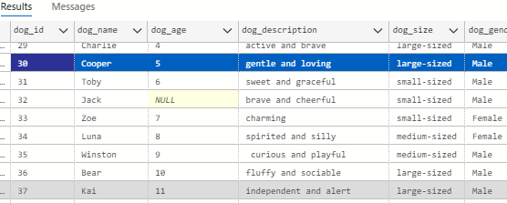

Slide 14
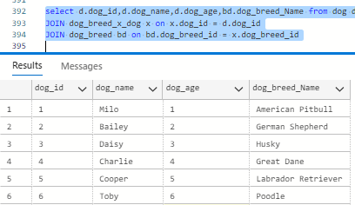
Example Queries
Find dog and dog breed

Slide 15
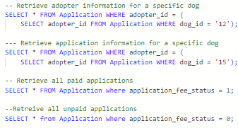
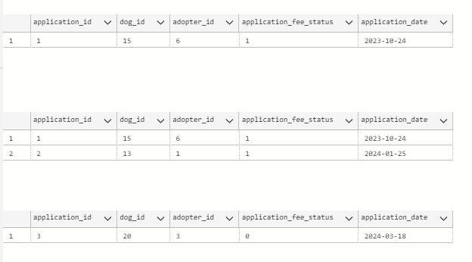
Results from Queries

Slide 16
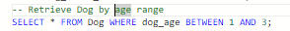
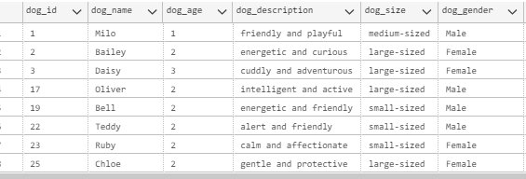

Slide 17
Risks and Assumptions
Risks:
Data accuracy
Security concerns
User Error
Integration with other services/applications
Bottleneck and performance issues
Assumptions
Availability of the Dogs
Accuracy of the Information
Honesty
Technology
Community Response
Notes:
Here are some risks and assumptions that we had for our project:
Risks/Issues:
Data Security – With having so much data on actual adopters, we are at risk for potential data breaches. This includes the personal details of the adopters or even medical records of dogs, even though they are not protected by HIPAA. We want to make sure we have security measures in place, and limited access to certain information. If we are working with other applications, we may have to share sensitive data, so there could be some weaknesses in these systems.
Data Accuracy - Sometimes the applications can be inaccurate which could lead to errors in the application process. We would need to make sure the fields are listed as required or for the fields that are not, making sure it is labeled correctly. We would also want to train our staff to properly input the information as well.
System Performance - We want to make sure that the database can be properly used on different systems. We don't want to have delays in processing applications. We would want to make sure we have reliable systems to help run this.
Legal Compliance - We need to make sure since we have access to first-party data that we are being compliant with all applicable laws. We wouldn't want to be fined or given other consequences.
Integration with other Services or Applications: Working with another platform could lead to compatibility issues which could cause errors in the data or even the functionality of the database. We also would have to depend on the other application to be working at all times.
Assumptions
Availability of the Dogs: In the database, it may seem like a dog is available, but real time availability may vary and dogs can be adopted or become unavailable before being updated in the system.
Accuracy of the Information: Humans are putting in the information about the dog, including their breed, age or even their medical history, errors are bound to occur. We would like it to be accurate and up-to-date, but errors can happen.
Honesty: We are assuming adopters are going to be honest on their application about their living styles or preferences, but we are also assuming our staff is going to be honest about each dog's condition and temperament. During this screening process, it is bound to lead to some type of discrepancy. We want to reduce that.
Technology: We need to make sure our own organization has access to technology and a stable internet connection to maintain this dog adoption database. We are also assuming this database will be able to be accessed by all parties involved (minus the dogs who don't have Wi-Fi)
Community Response: We are assuming people are going to be in support of our dog adoption center and want to participate in adoption events. But it could very easily differ on the support from the surrounding community and them being open to using the database.

Slide 18
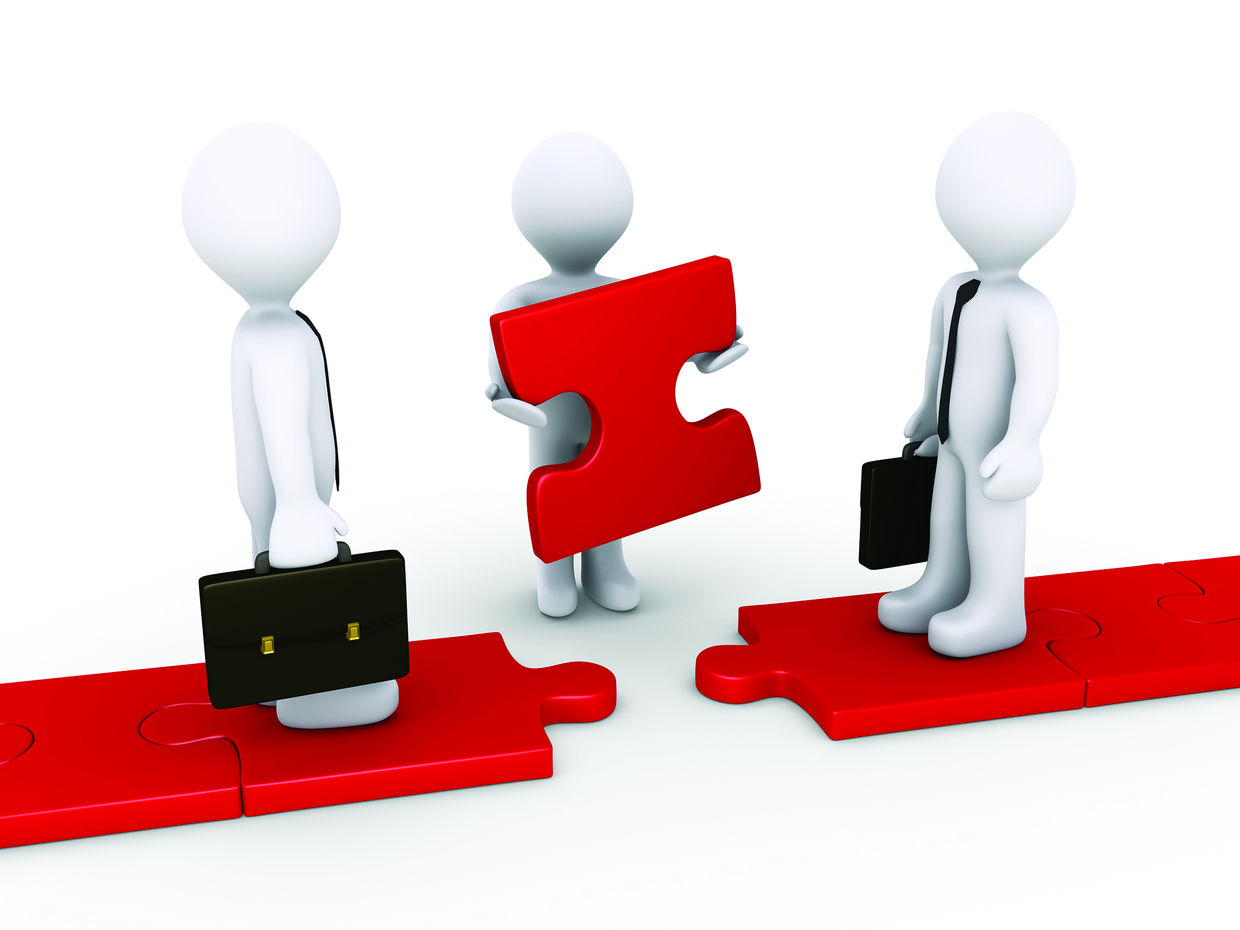
Conclusion
What our database does
Take away
What could be improved:
Adding hypoallergenic to dog breed information
What training the dog has
Adopter own/rental status
Adopter at-home schedule
Adopter fenced/not fenced yard status
Notes:
To wrap this presentation up, the database essentially connects potential adopters with dogs in need – and we're saving lives! Our main takeaway is that it is very important to have the proper documentation and records in the database to ensure each animal receives the proper care and attention they need. From filling out the intake form to keeping medical records accurate, these details are paramount to running an effective database for a dog shelter.
Some things that could be improved:
Adding hypoallergenic to dog breed information
What training the dog has
Adopter own/rental status
Adopter at-home schedule
Adopter fenced/not fenced yard status

Slide 19
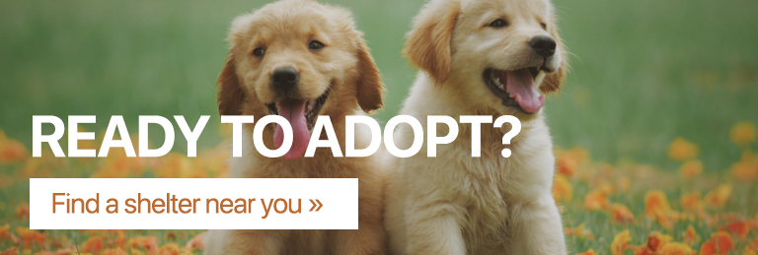
Thank you!
Questions or Comments?

Slide 20

In more detail...
The following slides provide in-depth details in regards to our previous slides...
Notes:
If needed, print out the following slides for speaking points during the presentation.

Slide 21
Why a Dog Database
Organized Information: It allows for the systematic organization of information about dogs available for adoption, including their characteristics, health records, and behavioral traits.
Efficient Matching: Helps in matching dogs with potential adopters based on their preferences, lifestyle, and compatibility, leading to successful adoptions.
Health Monitoring: Enables tracking of health records, vaccinations, and medical history of each dog, ensuring their well-being before and after adoption.
Improved Communication: Facilitates communication between the adoption organization and potential adopters, making it easier to provide information and updates.
Record Keeping: Provides a central repository for maintaining records of adoptions, which can be useful for legal and administrative purposes.
Data Analysis: Allows for the analysis of adoption trends, success rates, and other metrics, which can help in improving adoption processes and outcomes.
Educational Purposes: Can be used for educational purposes, such as teaching responsible pet ownership and promoting adoption over buying from breeders.
Community Engagement: Engages the community by providing a platform for volunteering, fostering, and supporting the adoption cause.
Transparency: Promotes transparency by providing information about the adoption organization's operations, policies, and the dogs available for adoption.

Slide 22
Business Need & Goals
The Business Need:
The dog adoption database will provide a centralized place for having information about dogs available for adoption, adopters, and the adoption process itself. This will make it easier to access information and streamline communication between all parties involved.
The database will also help expedite the process and make sure things run smoothly for both the adopters and our organization. This will lead to more successful adoptions and dogs will go to their forever homes.
Potential adopters will be able to filter to match dogs based on certain criteria, such as breed, size, age and lifestyle preferences. This will lead to more successful matches between the dog and adopter.
With the database and the data we collect, we'll be able to make informed decisions about how to best market and leave room for long-term planning. We'll be able to promote adoption events, share success stories, and even ask for volunteers through this database.
The Goal:
Similarly to the business need, the goal of the dog adoption database is to facilitate the successful matching of dogs in need of homes with the proper adopter while also making sure everything runs smoothly in the process.
We want to be able to manage information related to the dogs available for adoption and have everything in one place.
We also want to have filters or ways to pair dogs with potential adopters that would be on the best factors for the adopter. We want to reduce the risk of dogs being returned or having to re-home the dogs.

Slide 23

A dog adoption database is very beneficial, but there is also potential risks and issues.
Risks/Issues:
Data Security – With having so much data on actual adopters, we are at risk for potential data breaches. This includes the personal details of the adopters or even medical records of dogs, even though they are not protected by HIPAA. We want to make sure we have security measures in place, and limited access to certain information. If we are working with other applications, we may have to share sensitive data, so there could be some weaknesses in these systems.
Data Accuracy - Sometimes the applications can be inaccurate which could lead to errors in the application process. We would need to make sure the fields are listed as required or for the fields that are not, making sure it is labeled correctly. We would also want to train our staff to properly input the information as well.
System Performance - We want to make sure that the database can be properly used on different systems. We don't want to have delays in processing applications. We would want to make sure we have reliable systems to help run this.
Legal Compliance - We need to make sure since we have access to first-party data that we are being compliant with all applicable laws. We wouldn't want to be fined or given other consequences.
Integration with other Services or Applications: Working with another platform could lead to compatibility issues which could cause errors in the data or even the functionality of the database. We also would have to depend on the other application to be working at all times.

Slide 24
Assumptions
Availability of the Dogs: In the database, it may seem like the dog is available, but real time availability may vary and dogs can be adopted or become unavailable before being updated in the system.
Accuracy of the Information: Humans are putting in the information about the dog, including their breed, age or even their medical history, errors are bound to occur. We would like it to be accurate and up-to-date, but it can happen.
Honesty: We are assuming adopters are going to be honest on their application about their living styles or preferences, but we are also assuming our staff is going to be honest about each dog's condition and temperament. During this screening process, it is bound to lead to some type of discrepancy. We want to reduce that.
Technology: We need to make sure our own organization has access to technology and a stable internet connection to maintain this dog adoption database. We are also assuming this database will be able to be accessed by all parties involved (minus the dogs who don't have Wi-Fi)
Community Response: We are assuming people are going to be in support of our dog adoption center and want to participate in adoption events. But it could very easily differ on the support from the surrounding community and them being open to using the database.

